Slide 1
How I Made A Visual Novel In Ren’Py (And How You Can Too)
By: Jeremy W.

Slide 2

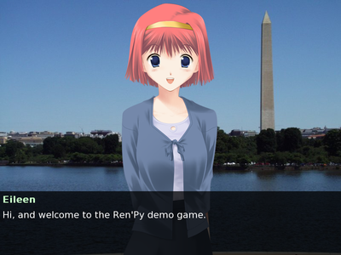
A (Brief) History Lesson
To put it in very simply words, a visual novel is basically a video game but with a focus on story, and with limited visuals, typically being made on the cheap.
They’re also traditionally romance stories, but don’t have to be.
Ren’Py (a portmanteau of ren’ai, the Japanese word for romantic love, and python) is built off pygame, a set of python modules made for making games.
In spite of this, Ren’Py’s language is a lot more of its own thing, with big parts of it almost being written like a screenplay.
It was created by Tom “PyTom” Rothamel.
The mascot, Eileen, a visual novel-esque character with a python around her (get it?)
An image of the tutorial VN included with Ren’Py

Slide 3
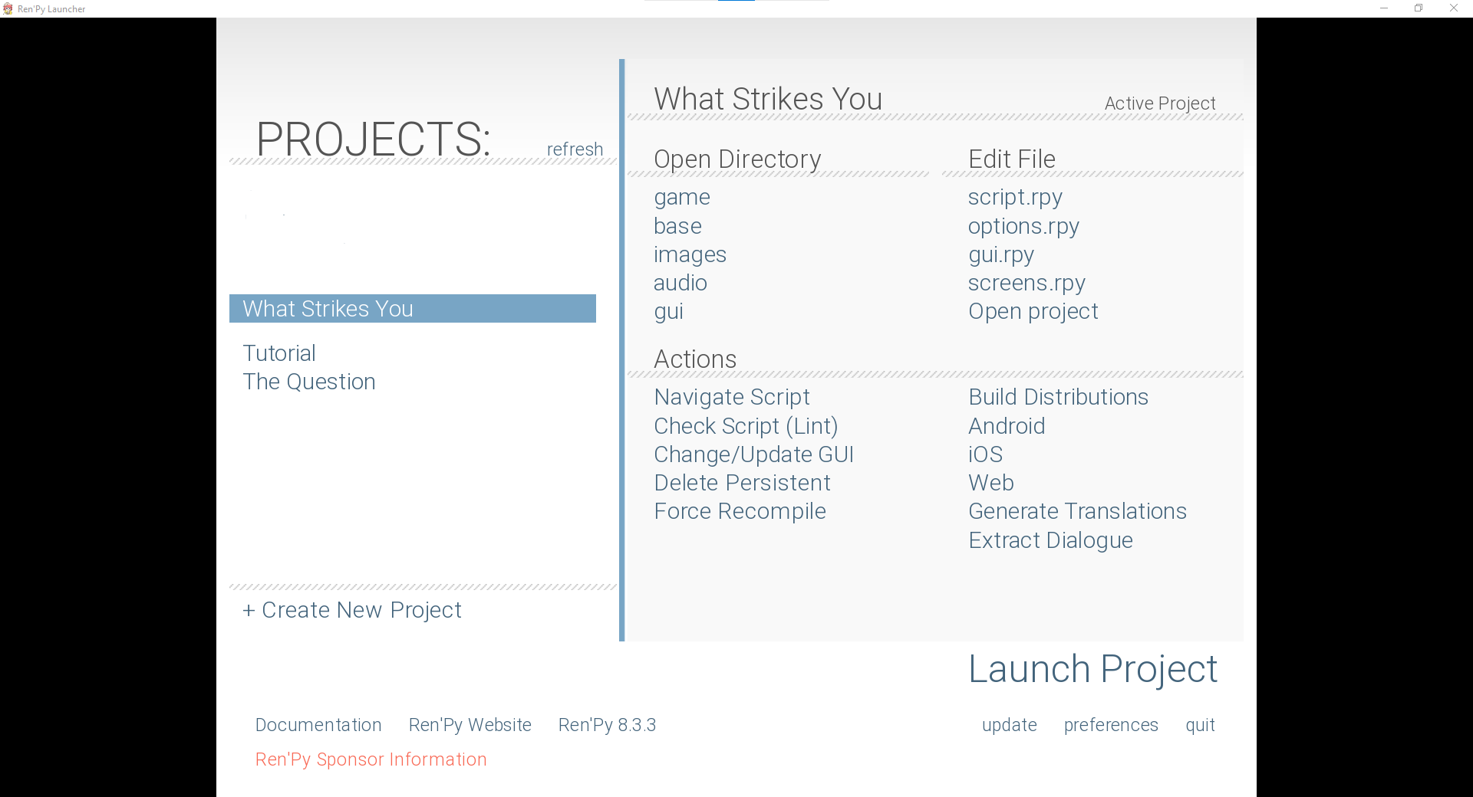
Setup
After downloading Ren’Py from the official GitHub and running the .exe, you’ll be met with a screen similar to this.
“What Strikes You” is the one I made, but “Tutorial” is a built-in tutorial with some basics, and “The Question” is an example of an actual VN.
The only other important things here (for this project) are:
“Create New Project” which does exactly that.
“Launch Project” which lets you run a VN in dev mode.
“Build Distributions” which lets you build the project.
“Open Project” which also does exactly that.
Note: Ren’Py doesn’t come with an IDE, so I’ve opted to use VSCode with a Ren’Py extension.

Slide 4

Languagey Elements, Pt. 1
This is an example of creating a character and having them say something.
The raw string in the character definition is the name that will appear above the text when this character is speaking.
“what_color” is the colour of this character’s text, not prefixing it with “what_” will have it affect the character’s name instead of their text.
Other text transformations can be made here, like italics=True, for example.
scene is for backgrounds, and looks for pngs/jpgs in the default “images” folder.
“room 4” is calling a file named room 4.jpg/png, and must be named in all lower case to call this way.
If you add “with” it expects a transition object or keyword, dissolve is a keyword, dissolving in for 0.5 seconds.
There’s also Dissolve() which takes a length in the brackets.
show is similar, but shown images can be stacked on scenes and each other, whereas scenes wipe out everything.
As a result, they have to be pngs, and you can specify a location on the screen with “at” then a location.

Slide 5
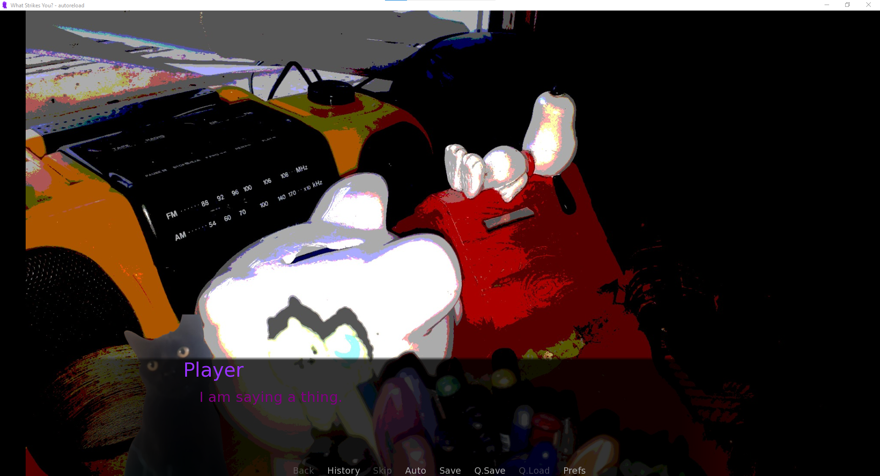
What That Example Looks Like

Slide 6
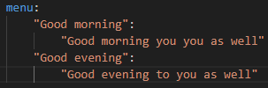

Languagey Elements, Pt. 2
Menus are how we let the user make choices.
Since Ren’Py is built off pygame which is obviously built off python, there’s still all the basics are in there, like if statements
But those work behind the scenes, not displaying anything to the screen.
menus do this, however.
Indents matter, so the furtherest indents here are code within the choices, the middle is the choices themselves, and then the main one is the menu keyword.
There can be an infinite amount of choices, just as there can be an infinite amount of elif statements.
Pausing could be described almost the exact same as Java’s sleep, but main thread safe.
It’s a function in the renpy, hence the dollar sign and calling it from “renpy”
3.0 is the pause length in seconds, and hard=True means it can’t be skipped by clicking/spacebar in the same way you do to advance text.
play is for playing audio, and audio files cannot be called in the same way as images.
There are three audio channels, music, sound, and voice.
stop is used to stop music, and since only one piece of audio can be played per channel, the file doesn’t need to be specified.

Slide 7
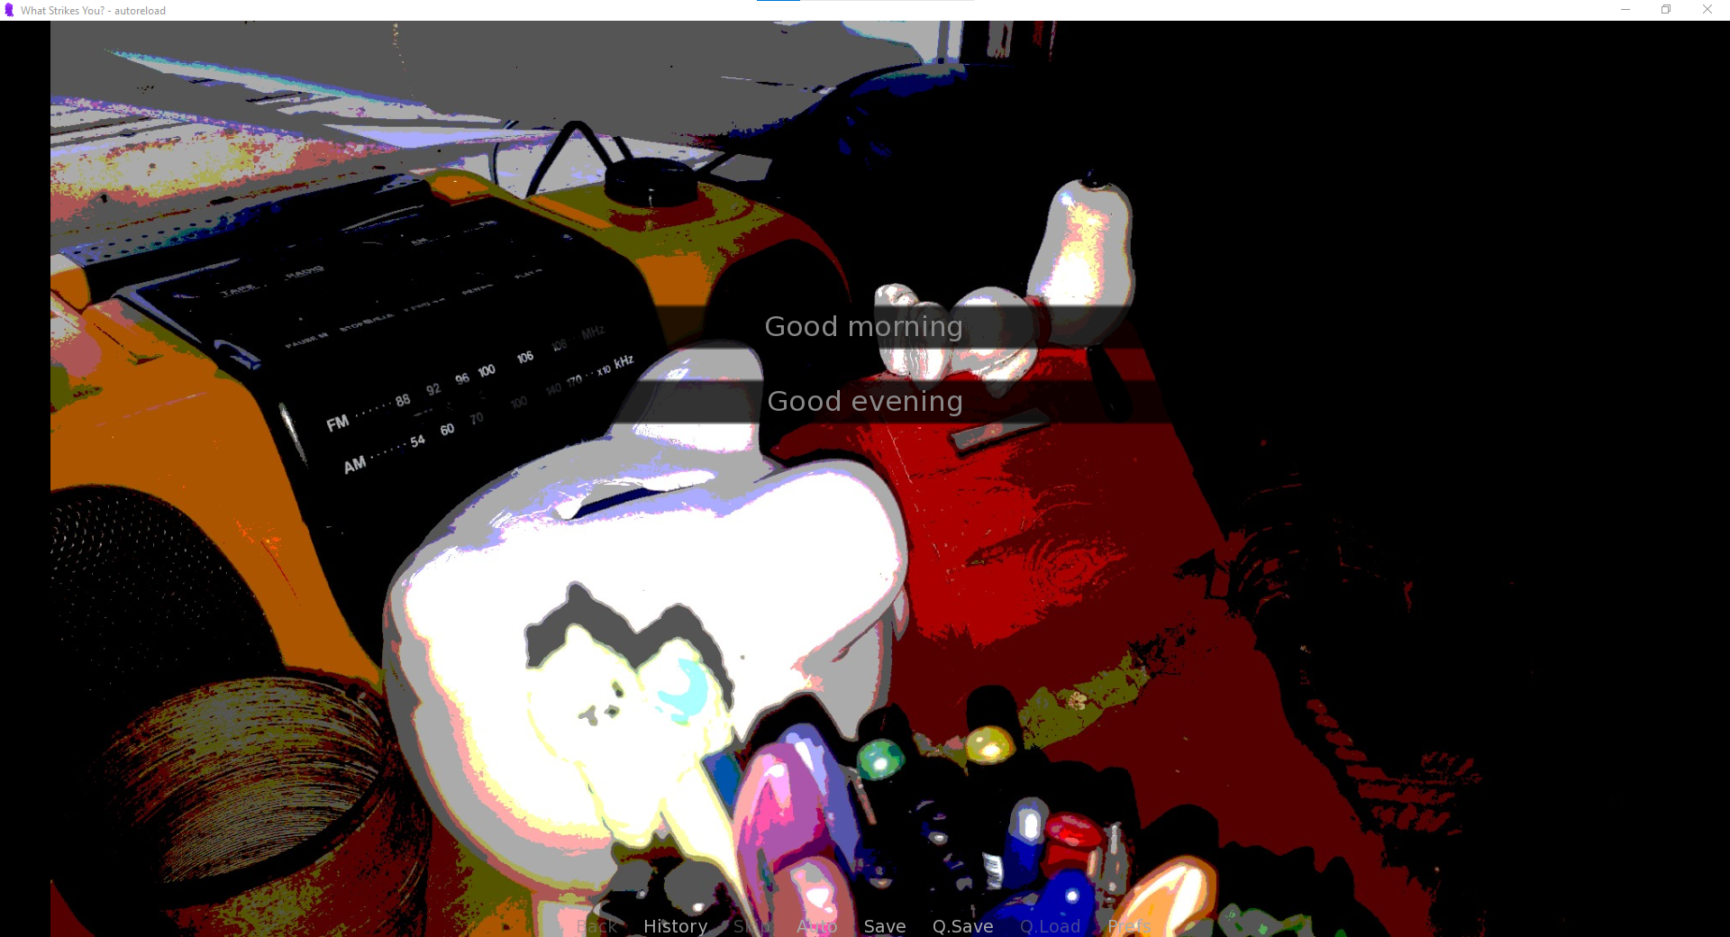
What That Example Looks Like

Slide 8
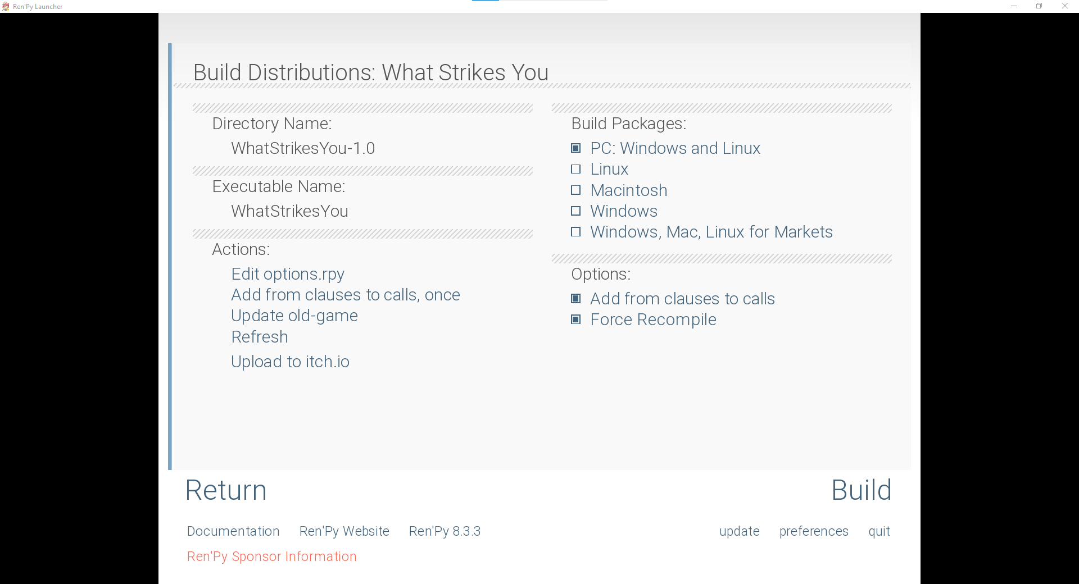
Exporting A Project/Hopefully I Have Enough Time To Show What I Made Running Live
After clicking the “Build Distributions” button on the main Ren’Py screen, it will take you here.
These are the main things you can build a Ren’Py project for, with ones that you have to download extra things for being separate options on the main page.
“Add from clauses to calls” is kind of an advanced thing to explain, but, in short, it makes it, so the game state is saved properly after code changes if you use “call” and “from” (which is for messing with save data, which you won’t have to do 99% of the time).
“Force Recompile” basically clears all save files, seen text, etc. so the compiled version is in a completely fresh state.

